Slide 1
Process and Thread Synchronisation Concepts
Mutual Exclusion: The Readers/Writers Problem
Note: Examples of the concepts presented here can be found in the RTExamples folder: Q11A
You are encouraged to open the project in Visual Studio and run the program
©Paul Davies 2020. Not to be copied, used, or revised without explicit written permission from the copyright owner. This lecture may contain animations and is best viewed as a slide show

Slide 2
Variations on Mutual Exclusion – The Readers/Writers Problem
We have seen previously that the use of a Semaphore or a Mutex is recommended practice when several competing threads must each have SOLE /EXCLUSIVE access to a non-sharable resource.
Such a scheme can impose significant delays, as each thread has to wait in turn waiting to acquire the resource one after the other, especially when a large number of threads are attempting to access the resource at very frequent intervals.
However, with some additional thought we soon realise that it is only important to enforce “true” mutual exclusion when one or more threads need to update the resource.

Slide 3
For example. If all the threads using the resource are simply reading, (that is, they absolutely guarantee that they will not attempt to update or write to the resource during that access), then it is perfectly acceptable for an unlimited number of such reading threads to be simultaneously active inside the resource without problems.
However, if any number of threads are reading from the resource, we must prevent any other thread from writing to it at the same time.
Similarly, if at least one thread is writing, we must prevent all other threads (both reading and writing) from accessing the resource at the same time.
The problem however, is that a semaphore or a mutex does not differentiate between threads that are only reading and those that intend to write.
To the semaphore/mutex, all Wait() calls look the same and thus every thread is treated exactly the same and has to line up and take in turns. No special privileges are applied to processes that are only reading.
This is a significant drawback, since in the field of concurrent programming, reading from a resource is performed, in general, far more frequently than writing to it and as reading is generally harmless, we should not have to limit the number of readers accessing the resource to just ‘1’ .

Slide 4
As an example, consider a distributed database application for an airline reservation system. Such a database may be simultaneously accessible by 1000’s of holiday booking agents all over the world when they are checking the availability of flights for a customer (i.e. only reading).
Such an operation could take several minutes to perform (while the agent talked over the options, departure times etc. with the customer). If we enforced true mutual exclusion on that database, then only one agent would be able to check the availability of flights for one customer at a time, imposing unacceptably long delays for the rest of the world (even though checking might only require access to the resource for a few seconds while the information is downloaded).
It would be far more desirable to allow multiple booking agents to simultaneously access the database to check flight availability, provided they only wanted to read the information and not book the flight.
If an agent wanted to actually book the flight then that should be a separate operation for which exclusive access (i.e. true mutual exclusion) would be required. No readers or other writers should be allowed to use the resource at that time.
In summary, it is desirable that we create a solution that would permit unlimited numbers of reader threads to be simultaneously active within a non-sharable resource, but enforce full mutual exclusion when ever a writer wishes access.

Slide 5
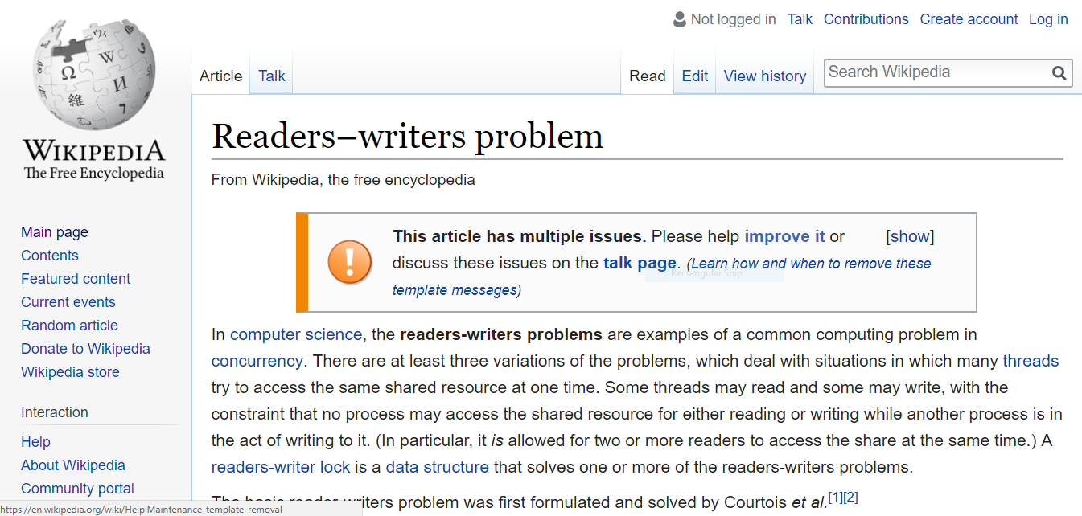
This problem is generally referred to in books on concurrent programming and operating systems as the readers/writers problem.

Slide 6
In attempting to come up with this more flexible solution to mutual exclusion, a new kind of mutex is required with separate Wait/Signal interfaces for Reader and Writer thread.
Set of Mutex Interface Functions for a Reader
Reader Thread
WaitToRead()
DoneReading()
Resource
Readers/Writers Mutex
Writer Thread
WaitToWrite()
DoneWriting()
Set of Mutex Interface Functions for a Writer

Slide 7
Each Reader must call ‘DoneReading’ when they have finished using the resource
Any number of Readers can call ‘WaitToRead’ and gain access to the resource provided that no Writer thread is active inside the resource at that time.
If a Writer is active in the resource, then all Reader threads will be suspended and have to wait outside the resource until the Writer leaves.
Reader Thread
WaitToRead()
DoneReading()
Resource
Readers/Writers Mutex
Writer Thread
WaitToWrite()
DoneWriting()
A writer can call ‘WaitToWrite’ and gain access to the resource. It will gain the resource only if there are no Reader and no other Writers using the resource at that time.
If this is not the case, all Writers will be queued outside and released one at a time into the resource when it is free. In summary ‘WaitToWrite’ will ensure that when it admits a single Writer only if there are no readers or other writers.
Each Writer must call ‘DoneWriting’ when they have finished using the resource

Slide 8
An Example “twin threaded” Program demonstrating the use of a ‘ReadersWritersMutex’
CReadersWritersMutex r1("MyRWMutex") ;
UINT _ _stdcall Reader (void *args) // reader thread function
{
for ( int i = 0; i < 100; i ++) {
r1.WaitToRead() ;
cout << "R" ; // Reader accesses the resource but must only read from it
r1.DoneReading() ;
}
return 0 ;
}
UINT _ _stdcall Writer (void *args) // writer thread function
{
for ( int i = 0; i < 100; i ++) {
r1.WaitToWrite() ;
cout << "W" ; // Writer accesses the resource but can read or write to it
r1.DoneWriting() ;
}
return 0 ;
}
A Global ReadersWritersMutex variable1 ‘r1’

Slide 9
Here is the main driver code to create 100 reader and 100 writer threads
int main()
{
CThread *TheReaders [100] ; // an array of 100 thread pointers to Reader threads
CThread *TheWriters [100] ; // an array of 100 thread pointer to Writer thread
// create 100 new Reader and 100 new Writer threads
for (int i = 0; i < 100; i ++) {
TheReaders [ i ] = new CThread( Reader, ACTIVE, NULL ) ;
TheWriters [ i ] = new CThread( Writer, ACTIVE, NULL ) ;
}
. . . // wait for them to finish and delete the objects
. . .
return 0 ;
}

Slide 10
Animation of Operation
Reader Performs
S.WaitToRead() to Gain Entry
No Writers Present: Reader Permitted to Enter
E
B
E
A
B
A
Reader Blocked by Writer
Reader Performs
S.DoneReading() to Leave
Resource
Resource
E
B
A
Reading
Readers / Writers Mutex ‘S’ Protecting Resource
Writer Performs
S.DoneWriting() to Leave
C
Writing
D
Writer Executes
S.WaitToWrite() to Gain Entry
C
C
D
D
Blocked by Reader
Writer Blocked by other Writer
Writer gains Entry
Writer gains entry because it arrived before waiting Reader
Resource is FREE to Both Readers and Writers
Resource is BUSY to Writers but OPEN to Readers
Resource is BUSY to Readers and Writers

Slide 11
Note:
The ReadersWritersMutex is not something that is directly supported by most Operating systems and so it has to be constructed as a class based around some of the concepts and building blocks defined in earlier lectures. Even C++ 17 which supports the concept of a readers/writers style mutex builds it into a library.
Let’s take a look at its implement in the rt.h and rt.cpp file.

Slide 12
class CReadersWritersMutex
{
int NumberOfReaders = 0 ; // keeps count of number of readers using resource
CMutex aMutex = 1 ; // a mutex to protect the ‘int’ above
CSemaphore aSemaphore = 1 ; // a semaphore acting as a mutex (set initially to 1)
// protecting the resource.
public:
void WaitToRead() { // called by a reader to gain access to the resource
aMutex.Wait(); // make sure only one reader is executing this code.
if( (++ NumberOfReaders) == 1) // if I am the only reader using the resource
aSemaphore.Wait(); // then NumberOfReaders will be 1 after increment
// so block any future writers by decrementing semaphore
aMutex . Signal() ; // allow other readers to execute wait() as well
}
void DoneReading() { // called when a reader has finished with resource
aMutex.Wait(); // make sure only one reader is executing this code
if( (-- NumberOfReaders) == 0) // last reader to leave the resource performs Signal
aSemaphore.Signal() ; // that would allow any waiting or future writers to enter.
aMutex . Signal() ; // release critical section to allow other readers to execute.
}
void WaitToWrite() {
aSemaphore.Wait() ; // If no readers or writers using resource, allow1 writer in.
} // this will block future readers and writers. Otherwise block
void DoneWriting() {
aSemaphore.Signal() ; // allow a reader or writer in if it is waiting.
}
};
Question: Why is the ‘Semaphore’ used in solution above? Why would a Mutex not work?

Slide 13
An Explanation
When a reader thread comes along and wants to access the resource, it invokes the WaitToRead() primitive. In theory if no other threads are using the resource, or if there are only readers using it, the new thread should be allowed to access the resource.
To prevent writers gaining access while readers are using the resource, the class keeps track of how many readers are accessing the resource at any point in time, thus when a reader wants access it has to increment the variable ‘NumberOfReaders’ which is of course initially set to zero.
(Note, this update will itself need protecting by it own mutex as several reader thread may be doing this at the same time. However this mutex is not shown in this outline to aid understanding. The full version in available in the rt.cpp library)
Once the variable NumberOfReaders has been incremented, a reader thread must check its value and if this is found to be 1, it implies that that reader is the only thread using the resource (there can be no other readers as the value would be more than 1 and no writers can be present for reasons outlined below). Therefore the first reader to gain access to the resource, performs a wait() on the readers/writers semaphore. This will have the effect of blocking access to any writers entering while there is at least one reader using the resource.

Slide 14
An Explanation (cont…)
When a reader leaves the resource, by executing the DoneReading() primitive the variable ‘NumberOfReaders’ will be decremented (again using mutex to protect this operation from simultaneous access by two readers leaving at the same time) variable while it is decremented. Now if the reader was the last to leave, indicated by the fact that NumberOfReaders is now 0, the Reader/writers semaphore is signalled allowing access to a single writer thread.
Once a writer thread gains access to the resource, (which means there can be no readers and hence NumberOfReaders = 0) any attempt by a reader to gain access to the resource will be blocked when it attempt to wait() operation on the Reader/writers semaphore. However it will be allowed in when the current writer leaves the resource and Signals the Reader/writers semaphore (waking up the blocked reader at the head of the queue)

Slide 15
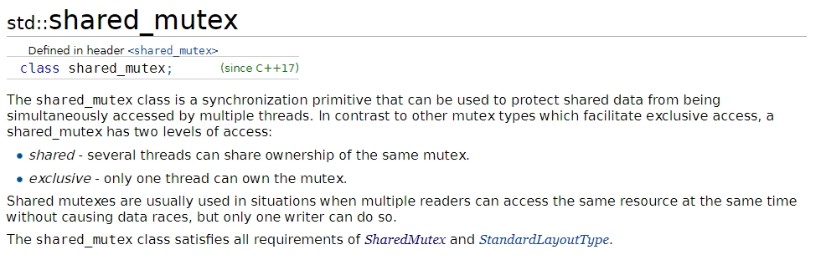
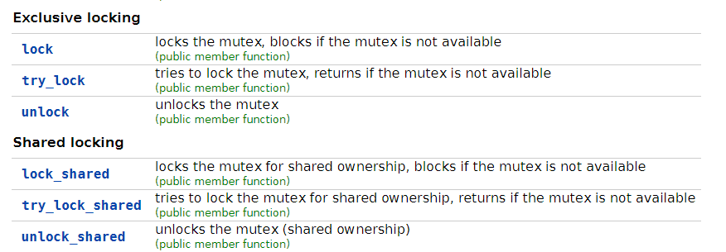
In C++17, the standard introduced the shared_mutex
Use limited to threads in same process
Lock and Unlock called by Writers
Lock_shared and Unlock_shared called by Readers
http://en.cppreference.com/w/cpp/thread/shared_mutex

Slide 16
Set of Mutex Interface Functions for a Reader
Reader Thread
lock_shared()
unlock_shared()
Resource
shared_mutex (C++ 17)
Writer Thread
lock()
unlock()
Set of Mutex Interface Functions for a Writer
See RTExamples - Q8 - TheReadersWritersProblem - C++ 2017 Version

Slide 17
An Example “twin threaded” Program demonstrating the use of a ‘ReadersWritersMutex’
shared_mutex r1 ;
UINT _ _stdcall Reader (void *args) // reader thread function
{
for ( int i = 0; i < 100; i ++) {
r1.lock_shared() ;
cout << "R" ; // Reader accesses the resource but must only read from it
r1.unlock_shared() ;
}
return 0 ;
}
UINT _ _stdcall Writer (void *args) // writer thread function
{
for ( int i = 0; i < 100; i ++) {
r1.lock() ;
cout << "W" ; // Writer accesses the resource but can read or write to it
r1.unlock() ;
}
return 0 ;
}
A global shared mutex variable1 ‘r1’

Slide 18
Giving priority to a Writer over a Reader
(still only 1 writer allowed)

Slide 19
Problems with the Readers/Writers Mutex: The WritersReadersMutex
There is one small problem with this algorithm/strategy as it is currently implemented, and that is, as long as there is a steady supply of reader threads using the resource, a writer thread may literally ‘starve’ because it can never find the resource totally free of readers, (a necessary condition for writer admittance to the resource). To prevent this situation, the algorithm could be rewritten thus:-
  When there is already one or more reader threads inside the resource and a writer thread arrives and wants access, then further reader threads should be blocked from immediate admittance to the resource until after the writer has been admitted and left.
  In this way, a writer thread only has to wait for the current reader threads already active within the resource, to leave before it gains access. It does not have to wait for reader threads that come along and try to gain admittance at the same time the writer is waiting.
  This solution prevents ‘starvation’ of the writer thread when there are many frequent accesses by readers.
  However with this solution the problem could shift from one of writer starvation to reader starvation, e.g. lots of writers blocking readers, however this is much less common as reading is usually performed far more frequently than writing.
  An example implementation is given below which is based around the class CWritersReadersMutex (see rt.cpp file for full implementation)

Slide 20
class CWritersReadersMutex
{
int NumberOfWriters = 0 ; // a new variable, keeps count of number of Writers waiting to use resource
CMutex bMutex = 1 ; // a mutex to protect the ‘int’ above,
CCondition aCondition = true; // an Initially Signalled/true condition allowing readers to gain access to the resource
. . . // plus other variables as used previously, e.g. semaphore etc
public:
void WaitToRead() { // called by a reader to gain access to the resource
aCondition.Wait() ; // if condition true, reader is allowed to proceed, otherwise blocked, condition is unchanged
. . . // as before in readers/writers mutex performing wait() on mutex and semaphore.
}
void DoneReading() { // called by a reader when leaving the resource
. . . // as before, condition variable remains unchanged by a reader leaving the resource
}
void WaitToWrite() { // called by a writer to gain access to the resource
bMutex.Wait(); // wait for exclusive access to class variable ‘NumberOfWriters’ above
if( (++ NumberOfWriters) == 1 ) // if I am the only writer waiting to gain access to the resource
aCondition.Reset() ; // reset condition and block future readers until this writer has released it
bMutex.Signal() ; // release critical section
aSemaphore.Wait() ; // wait until all other threads have left resource this includes any readers and any writers
}
void DoneWriting() {
aSemaphore.Signal() ; // allow next writer (or reader) into the resource based on first in line and able to go
bMutex.Wait() ; // wait for exclusive access to class variable ‘NumberOfWriters’ above
if( (-- NumberOfWriters) == 0 ) // if there are no more waiting writers
aCondition.Signal() ; // remove the condition blocking entry by readers
bMutex.Signal() ; // release critical section
}
} ;
Note there is no equivalent of the WritersReadersmutex in C++ 2017

Slide 21
An Example “twin threaded” Program demonstrating the use of a ‘ReadersWritersMutex’
CWritersReadersMutex r1("MyRWMutex") ;
UINT _ _stdcall Reader (void *args) // reader thread function
{
for ( int i = 0; i < 100; i ++) {
r1.WaitToRead() ;
cout << "R" ; // Reader accesses the resource but must only read from it
r1.DoneReading() ;
}
return 0 ;
}
UINT _ _stdcall Writer (void *args) // writer thread function
{
for ( int i = 0; i < 100; i ++) {
r1.WaitToWrite() ;
cout << "W" ; // Writer accesses the resource but can read or write to it
r1.DoneWriting() ;
}
return 0 ;
}
Note name change
A Global WritersReaders Mutex variable1 ‘r1’

